Slide 1

Revised Concept
Oliver Lewis – U1961638
Video & Post production
9/3/20XX
Presentation Title

Slide 2
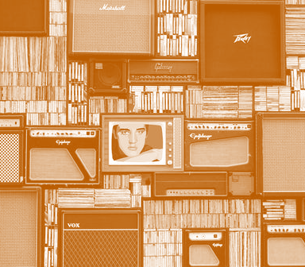
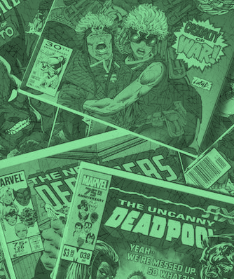
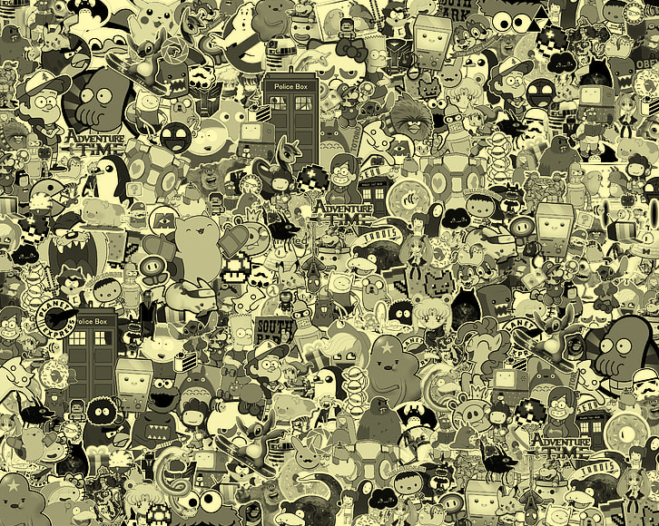
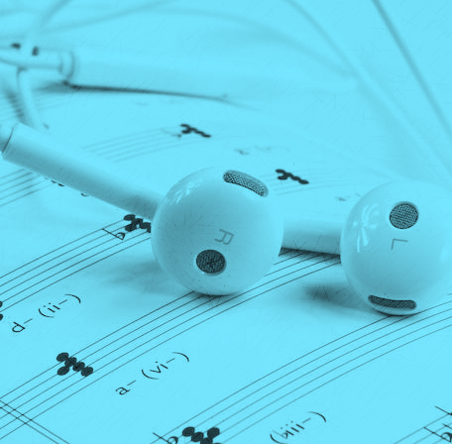
Concept
Rundown
mood boards of visual inspiration / references.
2-column script (1. Text/audio and 2.Describe the action)
12-20 frame storyboard - use bold shapes and clear indicators of movement. Presentation is key.
style frames illustrating the visual design of the intended video.
Presentation Title

Slide 3
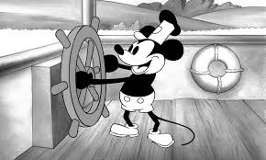
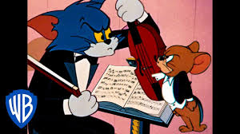

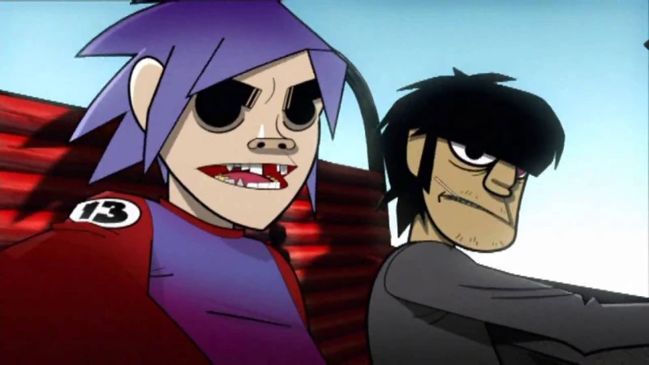
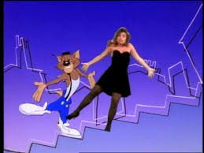
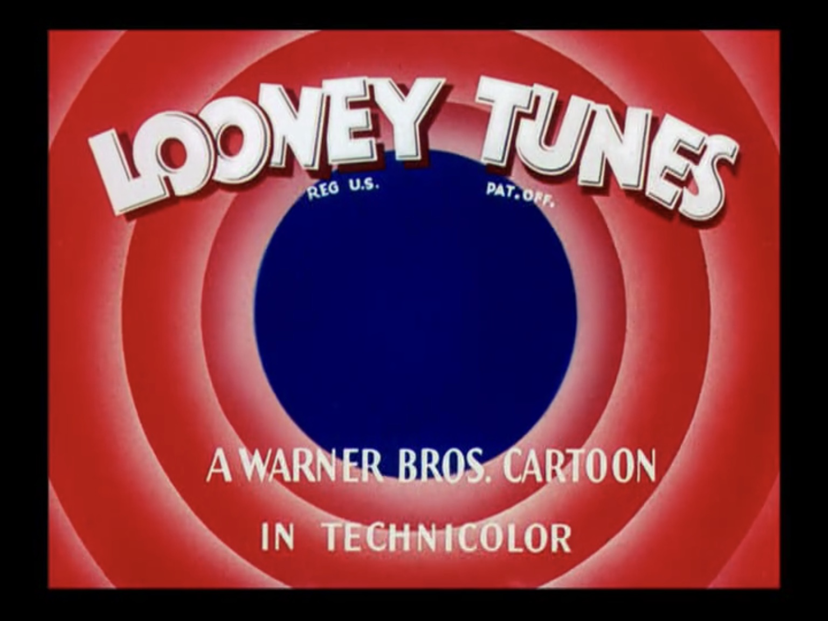

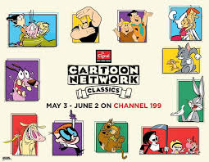
Inspirations
Gathering inspirations from a number of sources to come up with the original idea, the three main sources being: music videos, classic cartoons and pre-existing streaming services.
9/3/20XX
Presentation Title

Slide 4
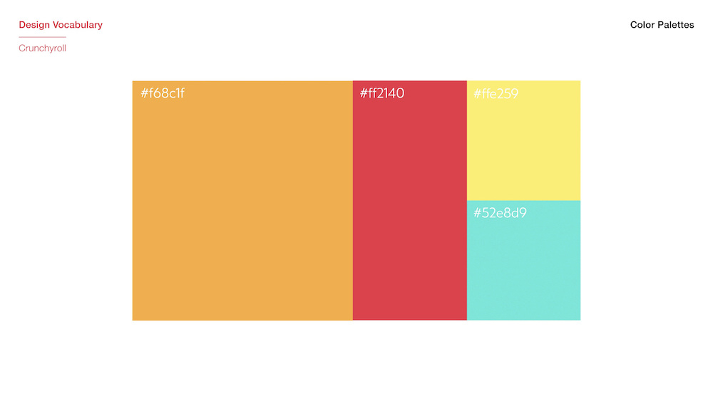
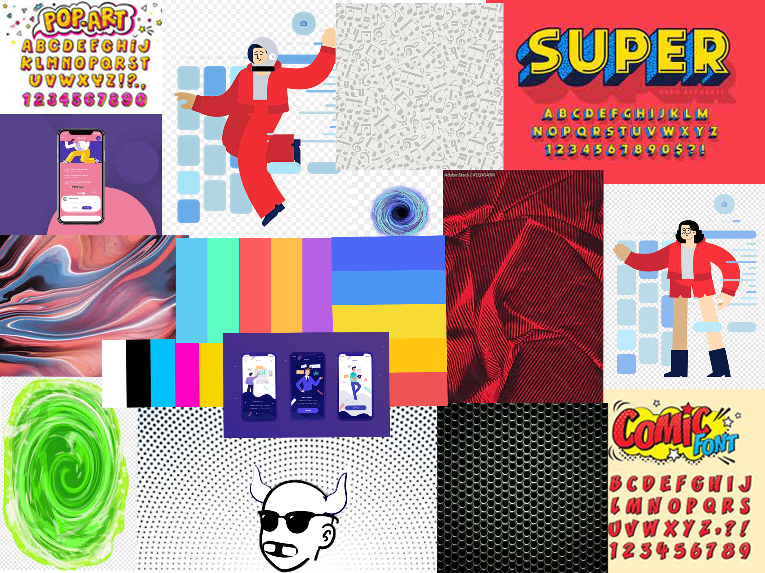
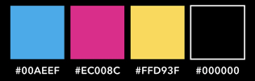
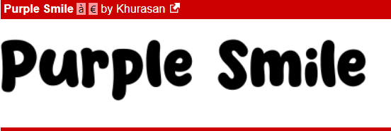
Mood board
Amalgamation of colour pallets, fonts, visual graphics, textures and layouts. Allowing for the generation of ideas for the overall and eventual look of the company.
9/3/20XX
Presentation Title

Slide 5
Script
Text/Audio | Action/Description
Scene 1: Audio voice over - Bored of your regular rundown streaming service? | User/customer with a bored expression sitting watching television while camera lowers bringing them into view.
Scene 2: Audio - Up-beat music begins to play Voice over - Imagine if you could stream your favourite cartoons and music on one service | Change in emotional tone, characters expression increases to a smile as colour returns to the screen, slow zoom towards character and tv.
Scene 3: Text – “Do not attempt to adjust your television” Audio - Up-beat music continues | Change to characters point of view, looking towards the television as regular broadcast is taken over, via text appearing on the screen.
Scene 4: Text – “stay tooned” Audio - Up-beat music continues | Animated text flies in from the left and then the right telling the user to stay tuned for the advertisement they're about to be shown.
Scene 5: Audio - Up-beat music continues | Radial animation expands outwards from the television screen slowly engulfing the view of the camera.
Scene 6: Text – “Cartoons, sound tracks, theme songs, AMV’s, Music & Music videos” | Animated text drops down in order on the screen, listing the various features of that the streaming services will offer.
Text/Audio | Action/Description
Scene 7: Audio - Up-beat music continues | Transitional scene of radial circle shape animation receding inwards from previous scene.
Scene 8: Audio - Up-beat music continues | Users hand holding phone slides on screen from the left side, giving a close up of the mobile app in use.
Scene 9: Audio - Up-beat music continues | Point of view of user interaction with mobile phone, repeater animation exploding from phone when user presses buttons.
Scene 10: Audio - Up-beat music continues | Snap zoom towards mobile phone showcasing app features after user interacts with the app, zoom timed with interaction.
Scene 11: Audio - Up-beat music continues | Another radial animated transition scene, starting small in the centre of the screen extending outwards.
Scene 12: Text – “Toons” Audio - Up-beat music continues | Toons logo drops down from above the screen, while a hand holding a phone presenting the mobile app towards the camera, with animations in the background and overlayed.
9/3/20XX

Slide 6
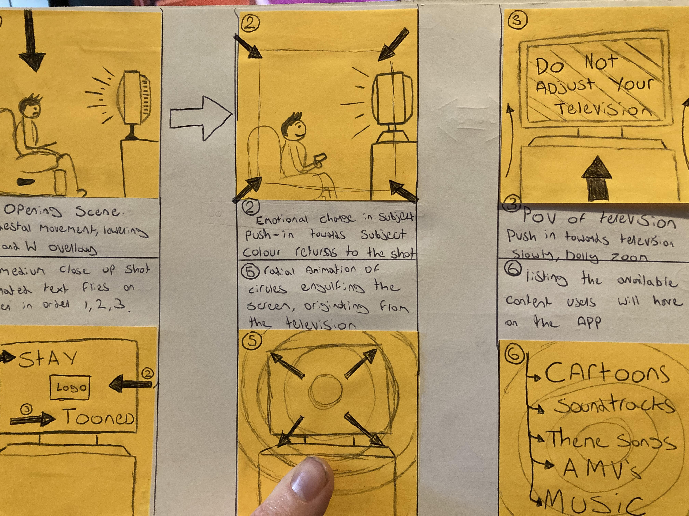
Storyboard – Frame 1-3
1
2
3
Scene 1:
Opening scene, pedestal movement, lowering the camera bringing the character and television into frame from a side on view. Black and white overlay over screen for emotional effect.
Scene 2:
Frame push in towards the subject slowly, overlay fades away from the bottom of as colour returns to the screen upwards.
Scene 3:
Change in view of scene from side on view to POV of television, slow dolly zoom towards the television screen as text appears on the tv screen.

Slide 7
Storyboard – Frame 4-6
4
5
6
Scene 4:
Medium close up shot of television screen, continuing POV from previous scene. Animated text flies on screen from left and right in top-down order.
Scene 5:
Radial animation of circles originating from the centre of the screen gradually engulfing the whole frame
Scene 6:
After the animation from the previous scene has reached its apex, a top-down list of available features will appear on the screen like a drop down menu.
Notes:
7

Slide 8
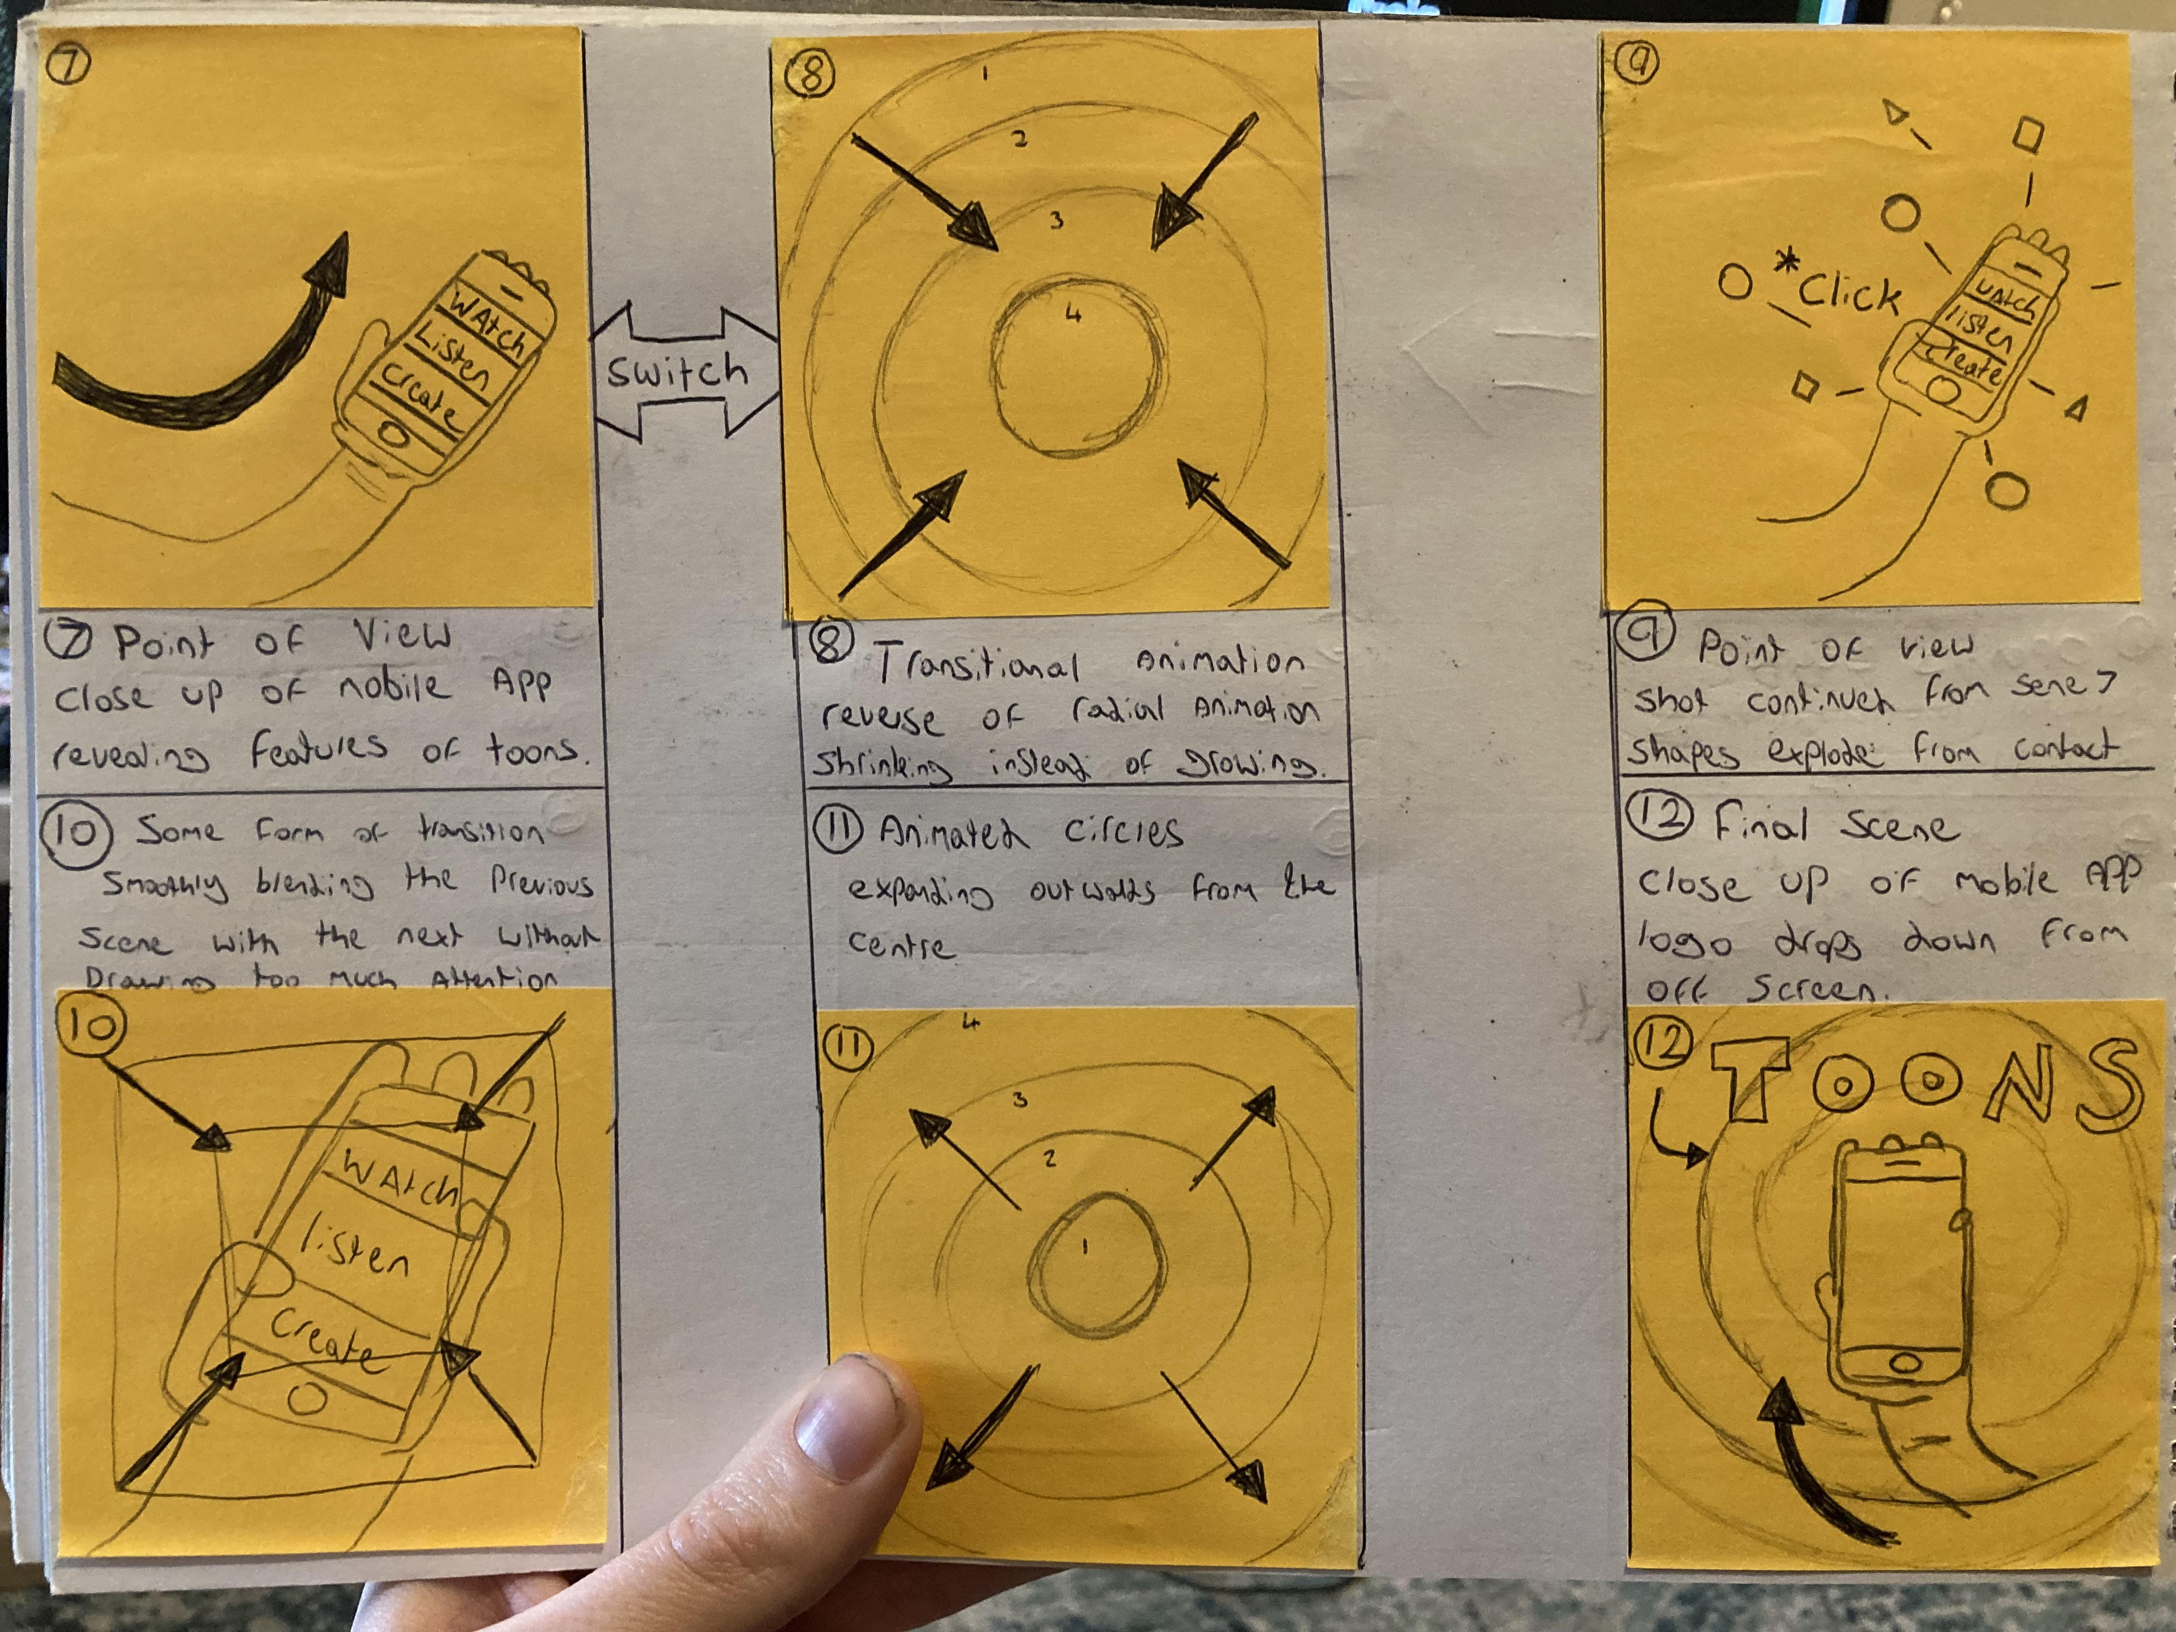
Storyboard – Frame 7-9
7
8
9
Scene 7:
Transitional animation from previous scene, animated circles receding inwards, fading into the centre of the screen. to transition into footage of services being used on phone.
Scene 8:
Arm appears from the left off screen holding a mobile phone while music plays over the top with voice over narration of features.
POV close-up of mobile phone revealing the design and layout of the app on a mobile platform.
Scene 9:
Continuation of previous scene where user interacts with mobile screen, clicking an option causing animated effects to appear from the phone screen on the point of contact.

Slide 9
Storyboard – Frame 10-12
Scene 10:
Scene 11:
Scene 12:
Notes:
9

Slide 10
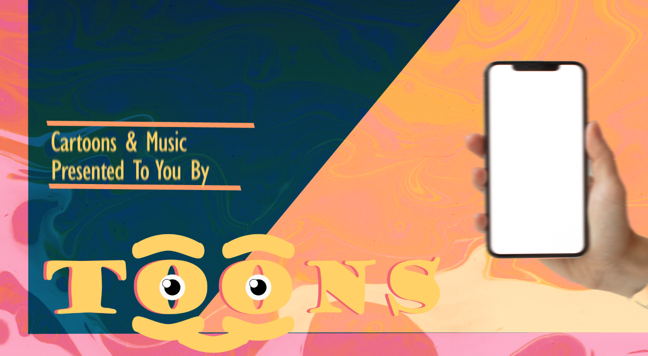

Slide 11
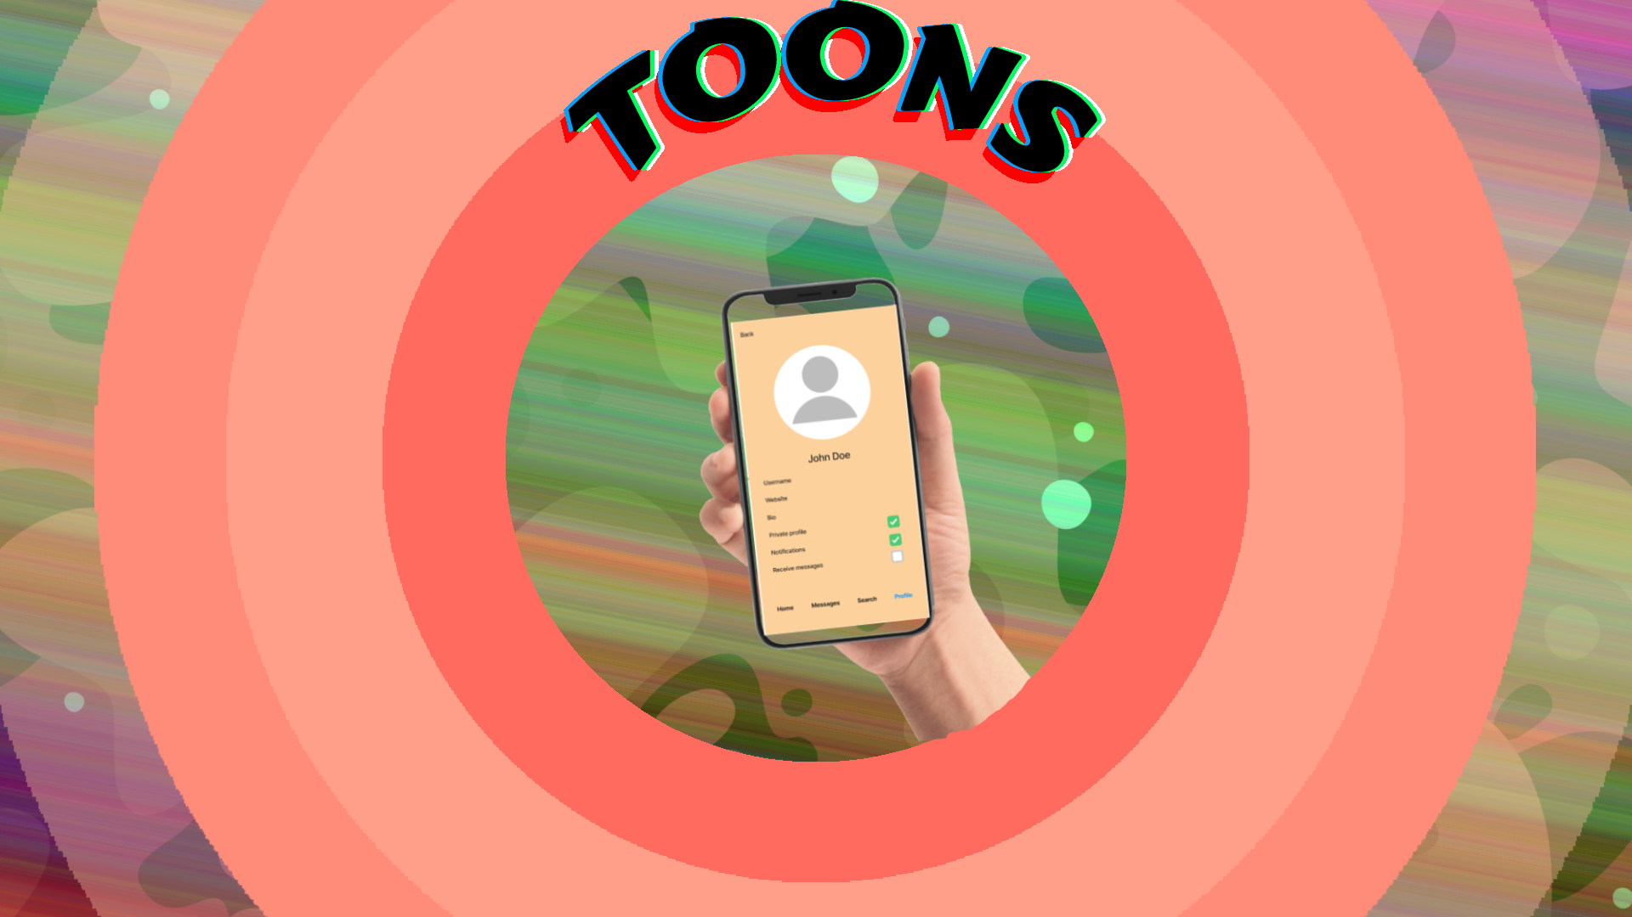
Notes:
10

Slide 12
Thank you
Oliver Lewis
Video & Post production
Notes:
10

